Slide 1
"A Spatial-Temporal Trust-Based Random Forest Framework for DDoS Attack Detection in 6G IoT"
Name: Abhay Ojha
Roll Number : 24CSM2R02
Guide Name : Prof. Rashmi Ranjan Rout

Slide 2
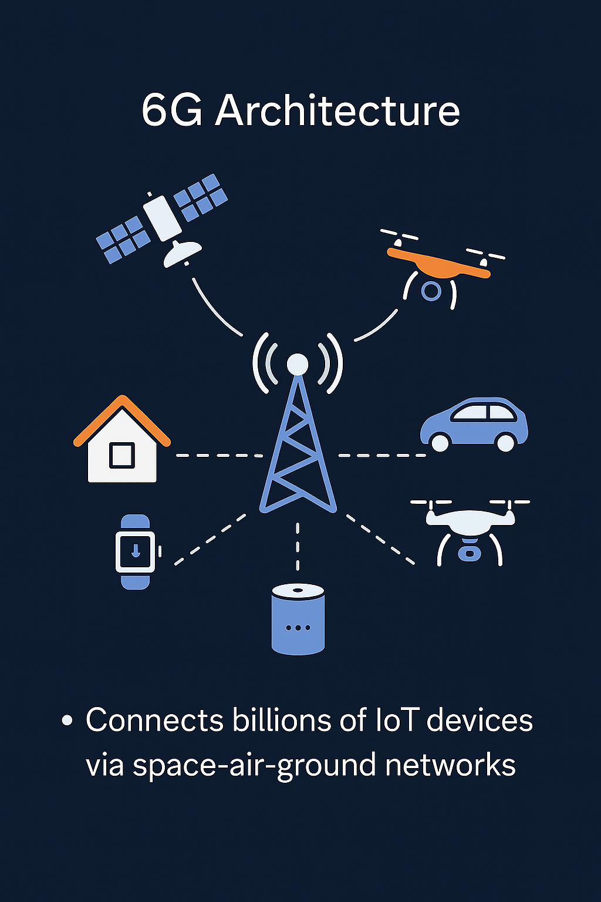
INTRODUCTION
6G and IOT Landscape:
6G connects billions of IoT devices via space-air-ground networks.
This massive scale introduces serious security challenges.
Rise of DDoS Attacks
IoT devices are poorly secured and easily hijacked.
DDoS attacks from compromised IoT devices now dominate internet traffic.

Slide 3
INTRODUCTION
DDoS Definition: Distributed denial of service (DDoS) attacks are attacks intended to manipulate many infected devices (bots) to send attack traffic to the target and deprive the target’s service ability.
IoT Devices in DDoS:
Most IoT devices lack strong security, making them easy to hijack and control as bots.
Many IoT devices lack proper security and are poorly managed.
Easily compromised and used as bots for launching DDoS attacks.
Compromised IoT devices have become the primary source of DDoS traffic.

Slide 4
INTRODUCTION
Detection Challenge in 6G IOT:
Traditional detection methods rely on fixed behavior models and struggle with IoT variability.
6G IoT networks face high dynamics, wide-area device distribution, and traffic heterogeneity.
Standard ML-based approaches are ineffective in such unpredictable environments.

Slide 5
INTRODUCTION
Why Trust Management
Trust models evaluate device behavior based on past communication patterns.
Originally used in ad hoc networks for bot detection with strong accuracy.
IoT devices show simple, unique patterns—making them suitable for trust-based evaluation.

Slide 6
INTRODUCTION
We design a lightweight DDoS detection system for 6G IoT using trust-based behavior analysis.
The system computes spatial and temporal trust values for each IoT node based on 4 key features.
These trust values, along with flow-level metrics, are used as input to a Random Forest classifier for final detection.
Combines real-time trust modeling with machine learning to improve detection accuracy and efficiency.

Slide 7
Problem Statement
Existing DDoS detection techniques either:
-Fail under 6G traffic diversity,
-Or require too much computational power.
There is very tough to find solution that balances accuracy, adaptability, and edge efficiency for DDoS detection in 6G IoT.
6G IoT needs a detection method that’s fast, adaptive, and lightweight — without sacrificing accuracy.

Slide 8
Problem Statement
Build a trust-driven DDoS detection method tailored for 6G IoT.
Ensure it works without pre-labeled data and scales across millions of IoT nodes.
Validate the model through real feature extraction, training, and attack detection experiments.
Our goal: An intelligent, real-time DDoS detection pipeline suitable for next-gen IoT.

Slide 9
Literature Survey
ML models like SVM, RNN, and ANN are widely used for IoT DDoS detection.
Require labeled datasets, high computation, and may overfit to fixed traffic patterns.
Example methods:
Doshi et al. used 5 ML classifiers with extracted features.
Jia et al. proposed edge-based dual ML defense (accuracy: 99.9%).
Limitation:
Difficult to deploy in resource-constrained 6G edge environments.

Slide 10
Literature Survey
Trust models assess node behavior based on past interactions, reputation, or recommendations.
Example methods:
Jayasinghe et al. used a combined reputation + knowledge approach.
Caminha et al. proposed semantic middleware for trust evaluation.
Alshehri et al. used centralized trust for communication.
Limitation:
Depend on trusted neighbors, lack real-time flow detection, or are not tested against ML methods.

Slide 11
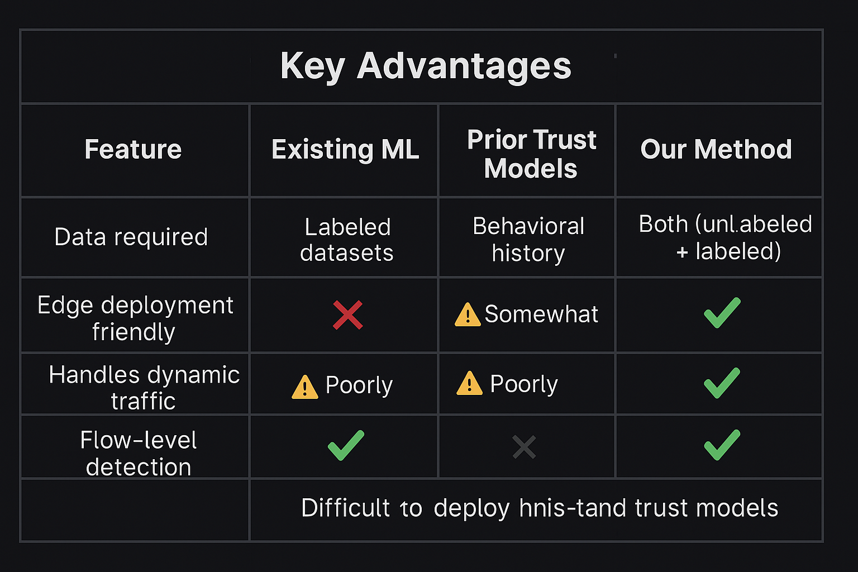

Slide 12
Proposed Architecture
A lightweight pipeline for real-time DDoS detection in 6G IoT, combining:
Behavioral trust computation
Flow-based metrics
Machine learning (Random Forest)
📌 Workflow Steps:
Feature Extraction
Implicit Node Clustering
Spatial & Temporal Trust Calculation
Flow-level Trust
Final Classification

Slide 13
Clustering
Objective: Establish a behavioral reference group for each time slot
Instead of traditional algorithms, we perform implicit clustering:
All active nodes in a time slot form one logical cluster
Median and standard deviation for each feature (k1–k4) are computed across all nodes
Used to measure deviation (Z-score) for spatial trust
📌 This approach adapts dynamically without explicit clustering overhead

Slide 14
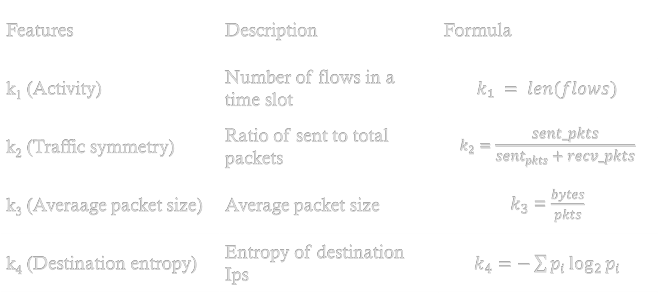
Features Extraction
📌 Features Computed per Node per Time Slot
Features | Description | Formula
k₁ (Activity) | Number of flows in a time slot | $$k₁ = len(flows)$$
k₂ (Traffic symmetry) | Ratio of sent to total packets | $$k_{2}=\frac{sent_pkts}{sent_{pkts}+recv_pkts}$$
k₃ (Averaage packet size) | Average packet size | $k_{3}$ = $\frac{bytes}{pkts}$
k₄ (Destination entropy) | Entropy of destination Ips | $k_{4}=−\sum{p_{i}\log_{2}{p_{i}}}$

Slide 15
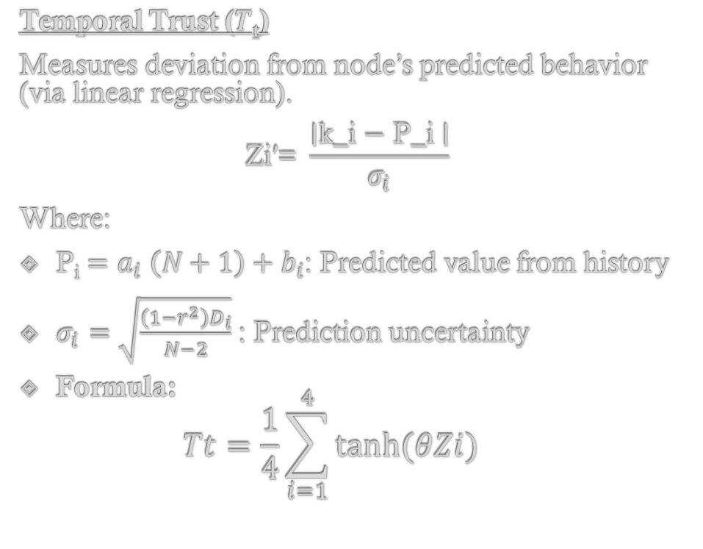
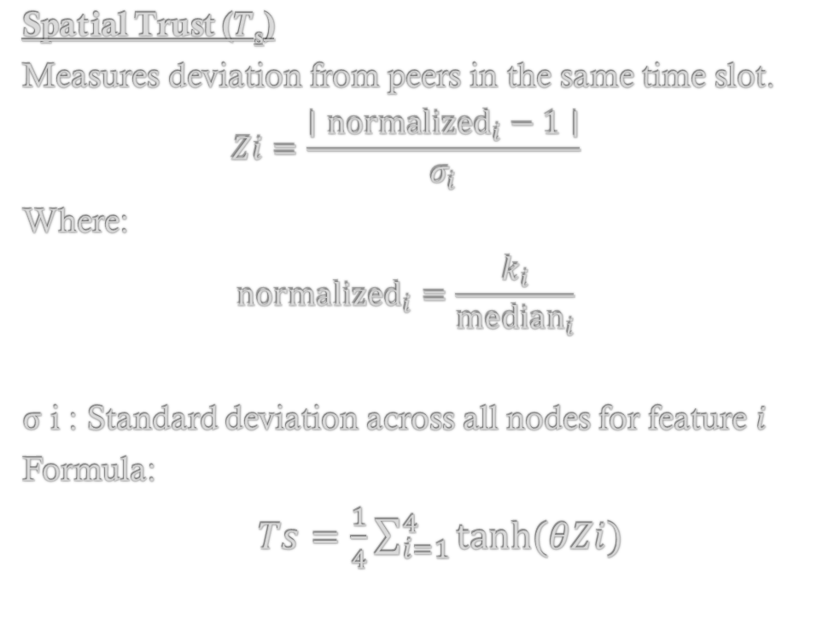
Spatial and Temporal Trust Calculation
Spatial Trust (𝑇_{s})
Measures deviation from peers in the same time slot.
$$Zi=\frac{∣{normalized}_{i}−1∣}{σ_{i}}$$
Where:
$${normalized}_{i}=\frac{k_{i}}{{median}_{i}}$$
σ i​ : Standard deviation across all nodes for feature 𝑖
Formula:
$Ts=\frac{1}{4}\sum_{i=1}^{4}{tanh⁡(θZi)}$
Temporal Trust (𝑇_{t})
Measures deviation from node’s predicted behavior (via linear regression).
$$\text{Zi}\text{′​=} \text{​}\frac{\text{∣}\text{k}\text{​}\text{_}\text{i} \text{−} \text{P}\text{_}\text{i} \text{​∣}}{σ_{i}}\text{​}$$
Where:
P_{i} $=a_{i} ​\left(N+1\right)+b_{i}$​: Predicted value from history
$​​​σ_{i}=\sqrt{\frac{\left(1−r^{2}\right)D_{i}}{N−2}}$: Prediction uncertainty
Formula: $Tt=\frac{1}{4}\sum_{i=1}^{4}{tanh⁡(θZi)}$
📌 Note:
Θ: is a tunable parameter controlling trust sensitivity.
In our case, we use θ≈ln⁡(3)/2Z to calibrate so tanh(θZ) ≈ 0.5 for moderate deviation.

Slide 16
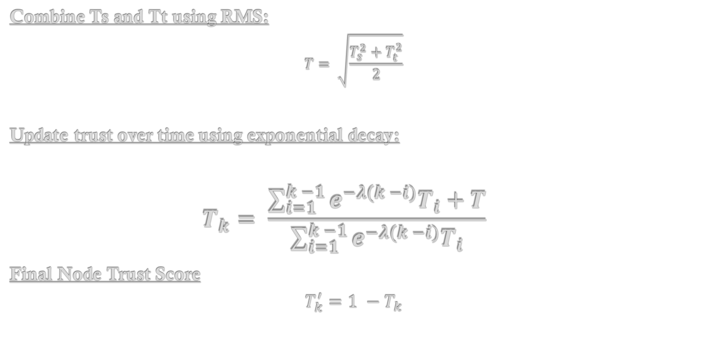
Node Trust Aggregation & Update
Combine Ts and Tt using RMS:
$$T= \sqrt{\frac{T_{s}^{2}+T_{t}^{2}}{2}}$$
Update trust over time using exponential decay:
$$T_{k}= \frac{\sum_{i=1}^{k −1}{e^{−λ(k −i)}T_{i}+T}}{\sum_{i=1}^{k −1}{e^{−λ(k −i)}T_{i}}}$$
Final Node Trust Score
$$T_{k}^{′}=1 −T_{k}$$

Slide 17
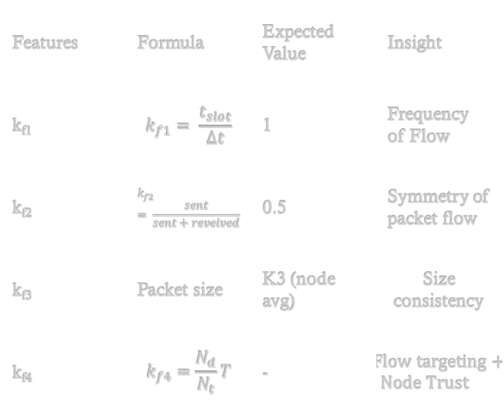



Flow Level Trust Score
📌 Goal: Evaluate each individual flow's trustworthiness, rather than relying only on node-level trust.
Features | Formula | Expected Value | Insight
k_{f1} | $$k_{f1}= \frac{t_{slot}}{Δt}$$ | 1 | Frequency of Flow
k_{f2} | $$k_{f2}= \frac{sent}{sent+reveived}$$ | 0.5 | Symmetry of packet flow
k_{f3} | Packet size | K3 (node avg) | Size consistency
k_{f4} | $$k_{f4}=\frac{N_{d}}{N_{t}}T$$ | - | $Flow targeting+Node Trust$
Trust Deviations:
$$F_{1}=tanh⁡(\text{θ}\text{∣}\text{k}\text{f}\text{1}\text{−1})$$
$$F_{2}=tanh⁡(\text{θ}\text{∣}\text{k}\text{f}\text{2}\text{−}0.5)$$
$$F_{3}=tanh⁡(\text{θ}\text{∣}\text{k}\text{f}\text{3}\text{−}k_{3})$$
$$F_{4}=\text{k}\text{f}\text{4}$$
Raw Trust Score per Flow:
$F= 1 −\frac{\left(F_{1} + F_{2} + F_{3} + F_{4}\right)}{4}$​​
Lower F→ more suspicious
Implements adaptive flow-level detection
Fusion with Node Trust:
$$TF= \frac{v_{f}}{v_{t}+v_{f}}.T_{k}^{′}+\frac{v_{t}}{v_{t}+v_{f}}.F$$
Where:
T’_{k} ​: node trust, F: raw flow trust v_{t,} v_{f} ​: variances of trust scores
Purpose: Combines historical node trust with real-time flow behaviour.

Slide 18
Random Forest Classification
Input Features:
k1–k4
Node Trust (T_{k})
TF
Classifier:
Random Forest (200 trees, depth=20, balanced classes)
Dataset balanced via undersampling
📌Predicts: Benign (0) or Attack (1)

Slide 19
Data Summary & Performance
Evaluation Setup:
Split: Node-based (70% train / 30% test)
Undersampling applied to balance classes
Classifier: Random Forest
200 trees, max depth 20, balanced class weight
Metric | Value
Total Flow | 36,59,470
Source Node | 21
Time Slots | 13
Benign Flow | 17,32,862 (47.35%)
Attack Flow | 19,26,608 (52.65%)
Metric | Result
Accuracy | 99.90%
Precision | 100% (Attack)
Recall | 99.97% (Attack)
F1-Score | 99.98%
ROC AUC | 99.90%
PR AUC | 99.90%

Slide 20
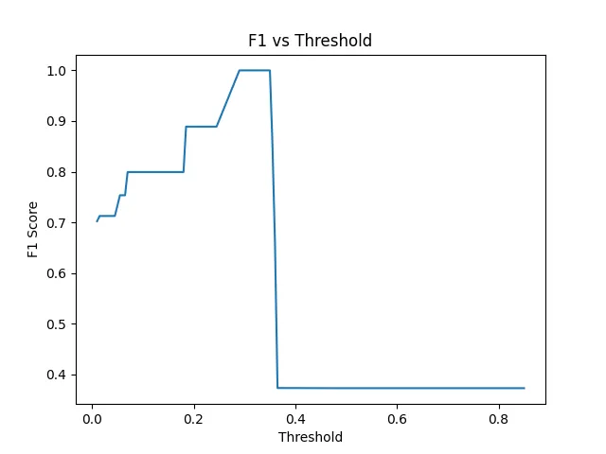
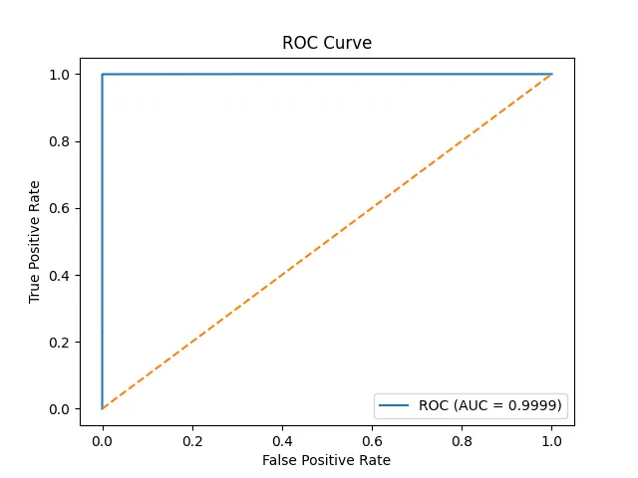
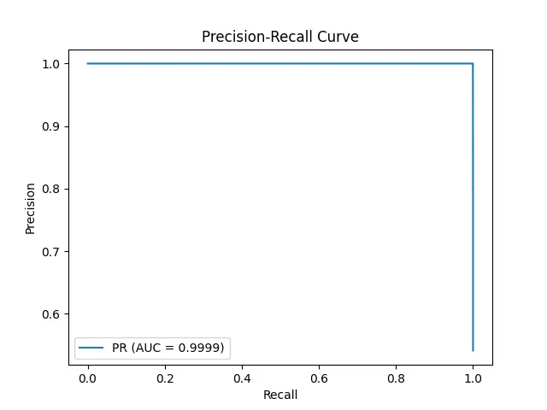
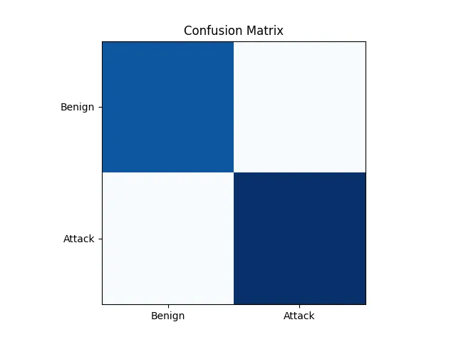
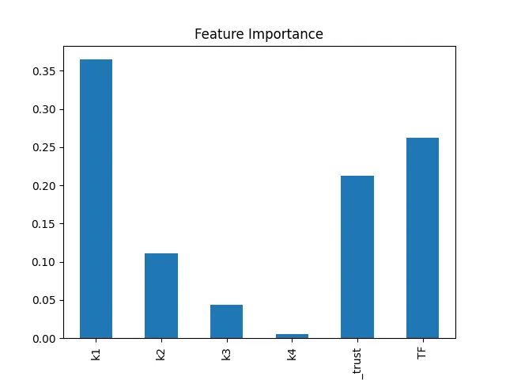
Data Summary & Performance

Slide 21
Conclusions
Key Takeaways:
A trust-based DDoS detection system was implemented for 6G IoT networks.
Combines spatial-temporal behavior analysis with Random Forest classification.
Achieved 99.98% accuracy, with excellent precision, recall, and robustness.
Detects attacks even from previously unseen nodes or patterns.
The model is lightweight, scalable, and ideal for edge deployment.
Future Enhancements:
Real-time deployment on live IoT gateways and testbeds.
Explore adaptive ML models (e.g., XGBoost, Online Learning).
Incorporate enhanced clustering techniques for better peer grouping.
Integrate with blockchain or federated learning for distributed trust management.

Slide 22
References
Yinglun Ma, Xu Chen, Wei Feng, Ning Ge,"DDoS Detection for 6G Internet of Things: Spatial-Temporal Trust Model and New Architecture,"China Communications, May 2022.
M. Badugu, N. L. Pusukuri, et al.,"A Novel DDoS Detection Mechanism: Trust Based Approach,"IEEE ICECCT, 2019.
R. Doshi, N. Apthorpe, et al.,"Machine Learning DDoS Detection for Consumer IoT Devices,"IEEE Security and Privacy Workshops (SPW), 2018.

